Slide 1
Unsupervised Classification on Hyperspectral Imagery
Introduction to Machine Learning and Pattern Recognition
Team Members:
Ali
Sruthikesh
Sean
Shashank
Patrick

Slide 2
Outline
Introduction
Implementation
Dimensionality reduction
Classification
Experiments and results
Localized PCA + split band PCA
Voting
Unsupervised Classification on Hyperspectral Imagery

Slide 3
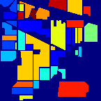
Introduction
Difficulties:
High dimensionality, Computationally Expensive
Limitation on unsupervised methods
Noisy data
Unsupervised Classification on Hyperspectral Imagery

Slide 4
Implementation
Dimensionality reduction
Unsupervised Classification on Hyperspectral Imagery

Slide 5
Implementation
Classification
K-means
C-means
LDA
Unsupervised Classification on Hyperspectral Imagery

Slide 6
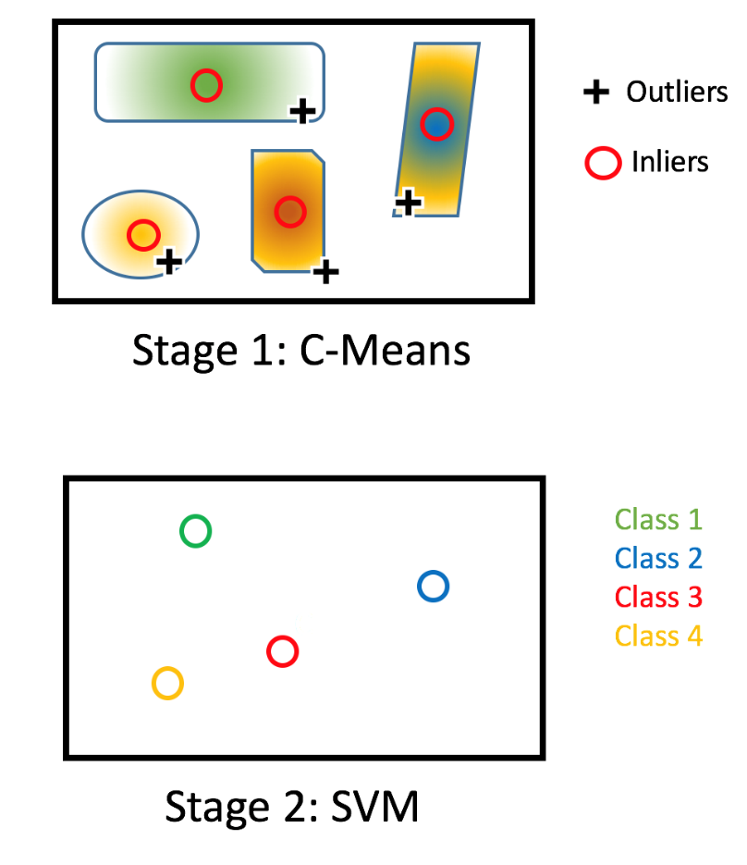
Implementation
Classification
Two Stage Classification
Unsupervised Classification on Hyperspectral Imagery

Slide 7
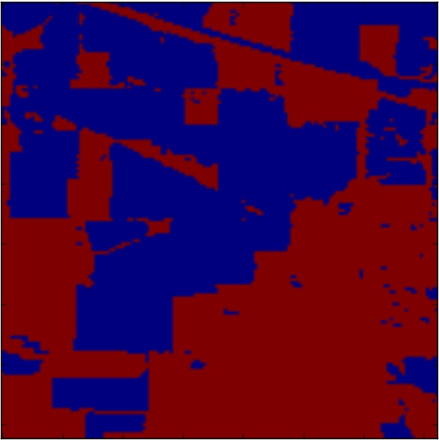
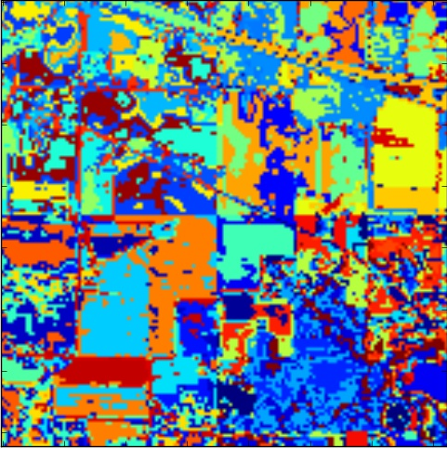
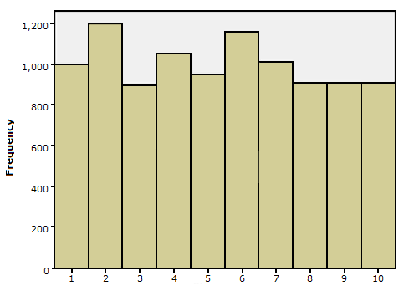
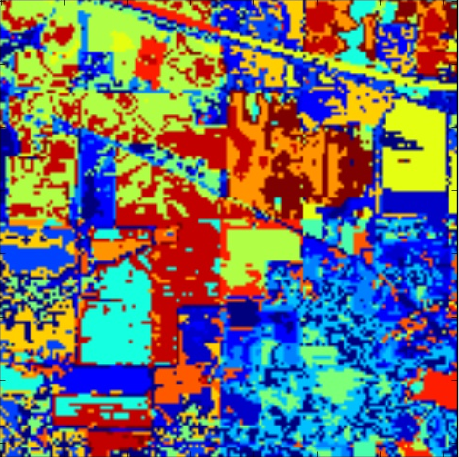
Implementation
Classification
LDA
Document Construction
Word Construction
Word distribution across documents construction
LDA (Topic mixture and topic per word is generated)
Image reconstruction
Unsupervised Classification on Hyperspectral Imagery

Slide 8
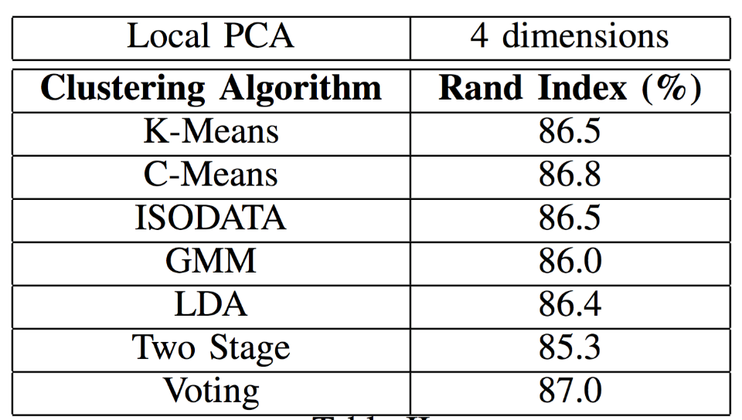
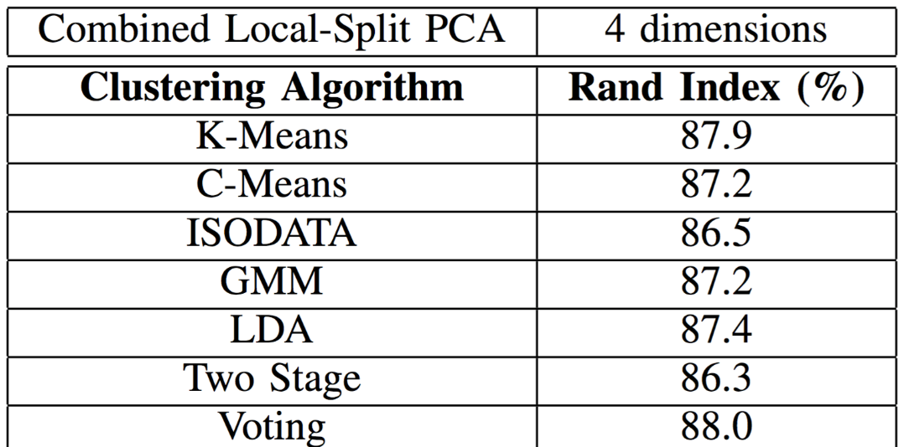
Experiments and results
Local PCA + Split Band PCA
Unsupervised Classification on Hyperspectral Imagery

Slide 9
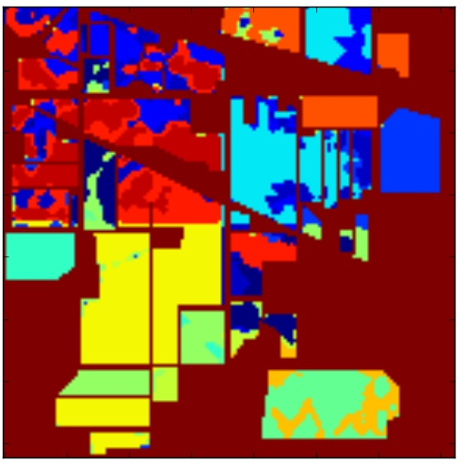
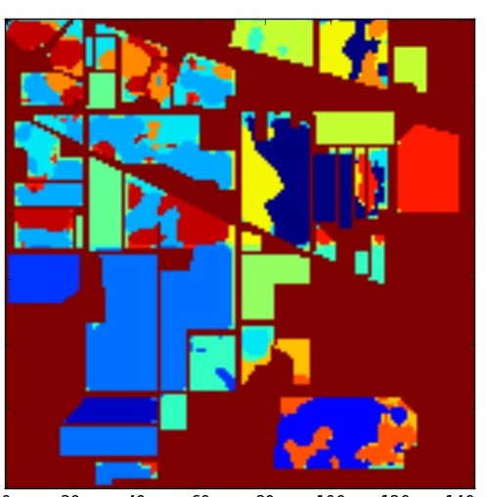
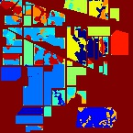
Experiments and results
Voting
88%
C-means
87.2%
K-means
87.9%
Unsupervised Classification on Hyperspectral Imagery

Slide 10
Thanks!!!
Questions???
Unsupervised Classification on Hyperspectral Imagery

